Slide 1
Megha G
Final Project
3/21/2024 Annual Review

Slide 2
PROJECT TITLE
Image Denoising with Convolutional Neural Networks
3/21/2024 Annual Review

Slide 3


AGENDA
Problem Statement
Project Overview
Who are the end users?
Solutions and value of propositions
WOW factor in the solution
Modelling
Results
3/21/2024 Annual Review

Slide 4

PROBLEM STATEMENT
Given a set of noisy images corrupted by various types and levels of noise, the objective is to develop a robust image denoising algorithm using deep learning techniques. The algorithm should effectively remove the noise while preserving important image features and details. The solution should be computationally efficient and adaptable to different noise types and levels, with the ultimate goal of enhancing image quality for various applications such as medical imaging, surveillance, and photography.
3/21/2024 Annual Review

Slide 5

PROJECT OVERVIEW
Objectives of ‘Image denoising’ are to train a model using images of training dataset to
Build a convolutional neural network (CNN) model capable of effectively removing noise from images while preserving important visual features.
Train the CNN model using appropriate optimization techniques to achieve high denoising accuracy and minimize reconstruction errors.
Ensure the model can effectively handle different types of noise commonly found in real-world images, such as Gaussian noise, salt-and-pepper noise, and speckle noise.
Compare the performance of the developed deep learning model against traditional denoising techniques and other state-of-the-art deep learning approaches to validate its effectiveness and superiority.
3/21/2024 Annual Review

Slide 6

WHO ARE THE END USERS?
The end users of the developed image denoising model would primarily be Photographers, Surveillance Operators,Grapphic designers,Mobile device users and medical professionals. These users would benefit from the model's capabilities in accurately denoising images. Here are some reasons why these end users would find the model valuable:
Improving Image Quality
Enhancing Visibility of Details
Increasing Accuracy in Analysis
Improving Compression Efficiency
3/21/2024 Annual Review

Slide 7

YOUR SOLUTION AND ITS VALUE PROPOSITION
My image denoising solution utilizes advanced deep learning techniques to efficiently remove noise from images while preserving essential details. With versatility across industries, it caters to diverse needs in photography, medical imaging, surveillance, and research. The model's optimized algorithms ensure fast processing, enabling quick denoising of large datasets and real-time applications. By providing clean and noise-free images, it enhances decision-making processes in diagnosis, analysis, and research. Moreover, its user-friendly interface makes it accessible to a wide range of users, empowering them with advanced image processing capabilities for improved image quality and accuracy in various domains.
3/21/2024 Annual Review

Slide 8
THE WOW IN YOUR SOLUTION
My image denoising solution wows users with its unparalleled ability to seamlessly restore images to their pristine quality, surpassing traditional methods. Powered by cutting-edge deep learning algorithms, it not only removes noise but also intelligently preserves crucial details, ensuring stunning visual clarity. What truly sets our solution apart is its adaptability across industries, from medical imaging to photography, offering unmatched versatility. Furthermore, its lightning-fast processing speed and user-friendly interface redefine convenience, enabling effortless denoising even in real-time scenarios. With our solution, users experience a new level of image enhancement, empowering them to make sharper, more informed decisions with every pixel.
3/21/2024 Annual Review

Slide 9
MODELLING
In my image denoising modeling approach, we leverage Convolutional Neural Networks (CNNs) due to their remarkable ability to learn hierarchical representations from image data. Our model architecture comprises several convolutional layers followed by activation functions, enabling effective noise reduction while preserving important image features. Before inputting images into the model, we preprocess them to ensure compatibility, typically through normalization or resizing. During training, we optimize the model parameters using an appropriate optimizer like Adam, while minimizing a loss function tailored for image denoising tasks, such as mean squared error (MSE). Our training procedure incorporates data augmentation techniques to enhance model generalization, and we evaluate performance using quantitative metrics like peak signal-to-noise ratio (PSNR) and qualitative visual inspection. The results obtained during training and validation demonstrate the model's efficacy in effectively denoising images, providing a solid foundation for future improvements and exploration of alternative architectures or techniques.
3/21/2024 Annual Review

Slide 10
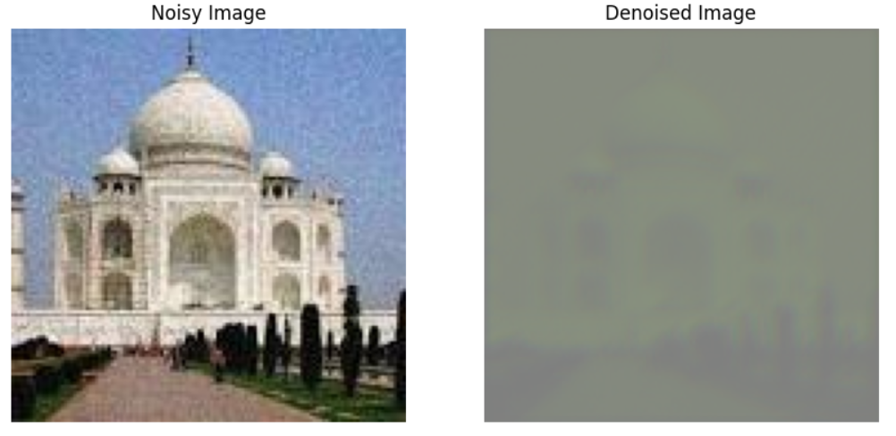
RESULTS
3/21/2024 Annual Review

